Slide 1
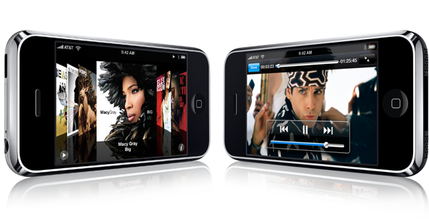
The Importance of Design

Slide 2
What makes an Effective UI
Allows user to intuitively interact with program
Gives the user a good first impression of the software
Makes the user’s job easier

Slide 3
Organization and Flow
UI Layout
Navigation
Consistency
Communication

Slide 4
Keep Your Users in Mind
Don’t know “how” app is supposed to work
Give clear instructions
Forgive mistakes
Highlight important areas/draw user’s attention
How Will the UI be used?
Tablet / Small Screen
Outdoors
Various resolutions

Slide 5
Tools of the Trade
Expression Blend
All types of interactive design for WPF
Expression Design
Even developers will use this on occasion to create graphics
Other tools you may encounter
Adobe PhotoShop and Illustrator
Other Expression Family Tools

Slide 6
Expression Blend
Tool of choice for WPF/SL UI design
Pleeeeease don’t use VS for this as you will come to hate WPF/SL if you do!
A quick lap around Blend
It’s not that different from Visual Studio
It’s just better for UI design
You will use it together with VS

Slide 7
Expression Design
Graphics design tool of choice for anything related to WPF/SL
This creates vector graphics
Designers are more likely to use Adobe Illustrator
You can import AI files pretty easily

Slide 8
Vector vs. Bitmap Images
Always aim to use vector images over bitmap based images
Use XAML over Jpeg/ Tiff/ Png/ Bmp
Vectors are significantly smaller, faster, and higher quality
Vectors also maintain fidelity in WPF/SL
Individual parts of vector images can be manipulated in code/XAML
Of course there are some images that are inherently bitmap based
Well, photos, basically

Slide 9
Various Bitmap Formats
If you have to use bitmap based files…
PNGs if you need any transparency
“A better version of GIF”
JPEG for photos
I would not use Windows BMPs in production development

Slide 10
Working with Colors
Add color last
Create resource dictionaries with colors
Choose color intensity wisely
Use color to draw intention to important things, while making secondary information less “in your face”
Example: Grid lines should not “jump out at you”

Slide 11
Color Associations - “Physiology of Colors”
Red
Active, dramatic.
Increases blood pressure and respiration rate.
Blue
Thoughtful, calming.
Blue slows human metabolism and produces a calming effect.
Corporate marketing color of choice (e.g. IBM, Dell, HP, Microsoft)

Slide 12
Color Physiology (cont.)
Green
Calming and relaxing.
The most restful color for the human eye and can improve vision.
Neutral color that can enhance creativity.

Slide 13
Color Physiology (cont.)
Black
Gives a feeling of perspective and depth.
Black backgrounds diminish readability.
When combined with other powerful colors (e.g. red or orange) gives a very aggressive color scheme.
Orange
Playful, informal, energizing.
Increases the supply of oxygen to the brain and stimulates mental activity
Very high visibility and can be used to highlight important design elements
"Non-corporate" marketing branding (e.g. MCI, Cingular, Vonage)

Slide 14
Color Physiology (cont.)
Yellow
Causes eye fatigue more than any other color.
Increases metabolism.
Causes irritability… babies are known to cry in yellow rooms and people lose their tempers more often in yellow rooms.
“Buttery” shades are easier to live with long-term than bright “sunflower” shades.

Slide 15
Color Physiology (cont.)
Pink
Shown to reduce angry behavior (temporarily).
Attempts have been made to use pink in prisons to control aggressive prisoners.

Slide 16
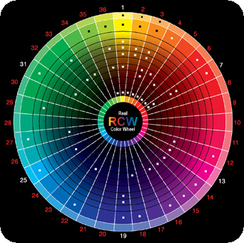
Color Schemes

Slide 17
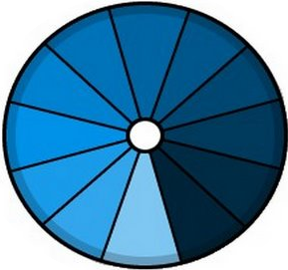
Color – Monochromatic Scheme
Variations in chroma and value within a single hue
Easy to manage
Always balanced
Lacks color contrast

Slide 18
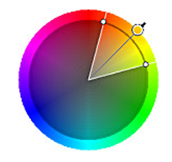
Color – Analogous Scheme
Adjacent colors in the primary color wheel
As easy to create as the monochrome scheme
Looks richer
Not as much contrast as other schemes
Too many hues can upset the color harmony

Slide 19
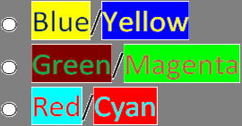
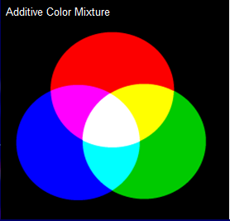
Color – Complementary Scheme (2)
Opposites on the primary color wheel
Pairs of colors that produce white light when additively combined

Slide 20
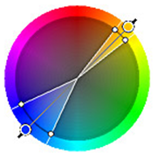
Split Complementary Scheme
Two analogous colors offset by a complementary color
Offset warm color against a cool color
Intrinsically high contrast

Slide 21
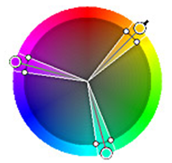
Color – Triacdic Scheme
Three colors evenly spaced (120 degrees) on the color wheel
High contrast
Retains some harmony
One color should be dominant

Slide 22
Adobe Color Wheel
https://color.adobe.com/create/color-wheel

Slide 23
Working with Gradients
Subtlety is key
As is the case in many graphical things
Gradients that stay within the same color but go from lighter to darker often look good
This imitates natural lighting and thus looks “right” to most people
Gradient direction and type can also be changed
Most linear gradients look good at an angle
I like to create circular gradients that are off-center

Slide 24
Fonts and Typography
Font sizes
Font Families
Styles (serifs vs. no-serifs)
Character and Line Spacing
Points vs. Pixels
Pixels = 1/96th of an inch
Points = 1/72nd of an inch

Slide 25
Shaders
Shaders are special little programs that run on the GPU
Pixel Shaders are called for every single pixel on the screen
Don’t worry: These Shaders are insanely fast!
WPF/SL Effects are implemented as Shaders, and you can create your own!
This is done in a special language called “HLSL” (High Level Shader Language)

Slide 26
Animations
Animations are incredibly important for a polished UI experience
Whenever in the past you changed a property value in the UI, you should now think about animating from the current value to the new value
Examples: Size, visibility, color, …
Animations are easy to create in Blend
Sometimes, I also create animations programmatically
Or I change existing ones on the fly programmatically

Slide 27
Animation Tips
Short (often think <= .5 or .3 seconds)
Subtle and “classy” over flashy and fancy
Make animations more dynamic using things like acceleration and bounce

Slide 28
Transitions
Animations from one UI to another are a good way to make a UI look polished and intuitive
Need proof? Check out the iPhone!
Transition animations can also be used as the user navigates in an existing UI
Example: Showing different parts of a screen, changing layout, or loading a new record
Transitions should never slow the user down!
For more, check out “Transitionals” on CodePlex

Slide 29
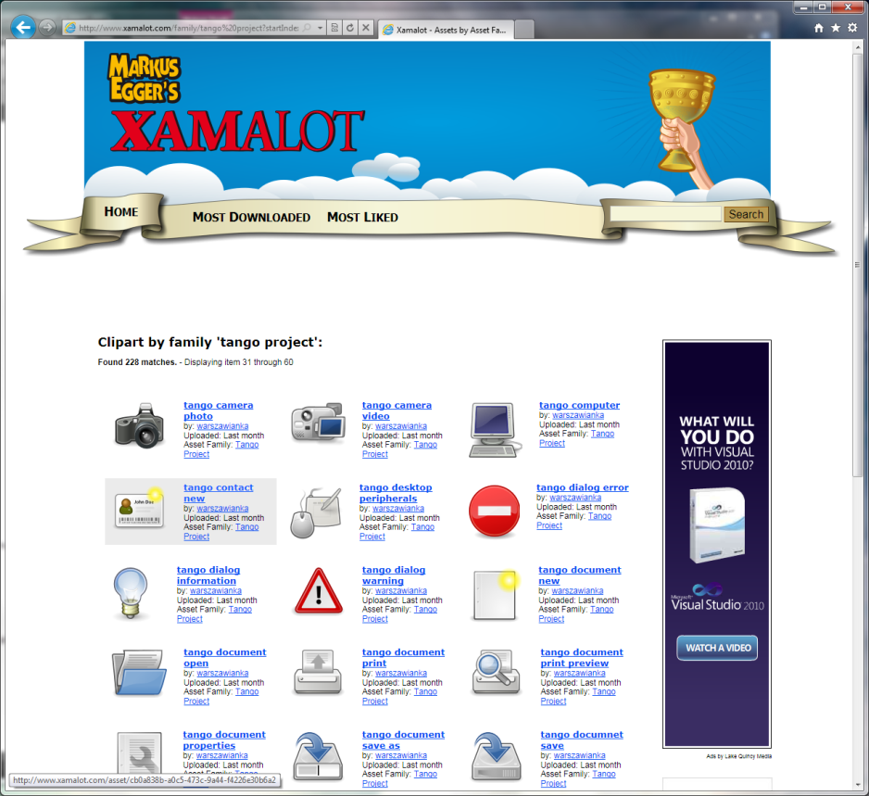

Xamalot
www.Xamalot.com
Free XAML clipart and more!

Slide 30
Styling Basics
Styles are simply property settings stored separately and applied on the fly
Styles can be applied automatically for certain types (“implicit styling”)…
…or based on a style name (“explicit styling”)

Slide 31
XAML Resources
WPF (“XAML”) allows for the definition of generic “things” as resources
Example: A standard color, or a font name, or…
Any WPF object/class is fair game
Definition Syntax:
<x.Resources> <Color x:Key="StandardColor">Red</Color> </x.Resources>
Usage Syntax:
<Button Background="{StaticResource StandardColor}" />
* XAML Resources are not to be confused with .NET Project Resources

Slide 32
Resource Dictionaries
Resource dictionaries are external “libraries” that only contain resources such as styles and templates
Resource dictionaries allow for easy separation of design and development
Resource dictionaries also allow for skinning
In fact, resource dictionaries could be loaded from an external URL…

Slide 33
Static vs. Dynamic Resources
Dynamic Resources are supported by WPF
Static resources are applied only once
Always applied right away, but fast
Dynamic resources are re-applied every time they change
Only applied when needed, but more overhead
Can also be changed on the fly easily

Slide 34
Programmatic Resource Access
Styles are standard .NET objects that can be accessed through the Resources collection
Resources can be manipulated programmatically
Especially in WPF
Note however, that due to static resource application, changes made to resources after they have been applied, changes may not be reflected

Slide 35
Resources Best Practices
Put your resources into resource dictionaries
Avoid putting resources into app.xaml as it quickly becomes unmanageable
Avoid putting stylistic resources into user controls and other UI-XAML files, as it mixes mechanics with visuals
For instance, you couldn’t give such as file to a graphics artist without potential to end up with a broken file
Separate different resources into different resource dictionaries
Example: All colors, all fonts, all control styles, all templates,…

Slide 36
Resources Best Practices (cont.)
You can put just about any object into resources…
...however: avoid UI elements
UI elements can generally only be used once, so it doesn’t make much sense to put it into resources
Avoid constant re-loading of resources for reusable resources
Example: Binding converters
Avoid resource over-use for things that do not need to be resources

Slide 37
Styles Explained
Imagine styles like CSS styles in HTML but more powerful
Styles define property values that can be applied to multiple controls
Either explicitly…
…or across all controls of a certain type
Styles can be simple values such as a color or a font size…
Styles can include templates which can define entire controls

Slide 38
Controls are “Lookless”
That means that WPF controls – by default – do not have a visual element
Therefore, controls are theoretically completely invisible
The visual aspect of controls is defined by Styles and Templates
These are defined by the developer/designer
If no style is defined, WPF applies a default style, to make sure controls always show up

Slide 39
Making Applications Styleable
Golden Rule: Define as little in individual XAML files as possible
Local settings override style settings
Thus: Once a property is set in a specific UI, it is not stylable anymore
Ideally, individual UI definitions only define mechanics (such as data binding) but no visuals

Slide 40
Templates Explained
Templates define the visual composition of elements or parts of elements
Example: Buttons are composed of various rectangles and a content presenter
Example: The makeup of an individual item in a list box
Templates also contain behavior such as animations

Slide 41
Templates vs. Styles
The definition of templates are stored in an element’s property
This just happens to be a very convenient place to store such a definition
Example: Template property on a button
As luck would have it, properties are stylable and thus, templates can be defined in styles
There is no other relation between templates and styles as the 2 concepts are completely independent

Slide 42
Skinning
When styles and templates are kept in Resource Dictionaries, they can be exchanged later programmatically to provide a completely different look for the application
var resources = (ResourceDictionary)XamlReader.Load(xaml);
Application.Current.Resources.MergedDictionaries.Add(resources);

Slide 43
Skin and Resource Organization
If you organize files smartly, you can achieve very simple yet powerful re-skinning results
Example: Break all colors into a separate file so you can switch colors without switching anything else
Note that dynamic and implicit resources make skinning much easier

